Slide 1
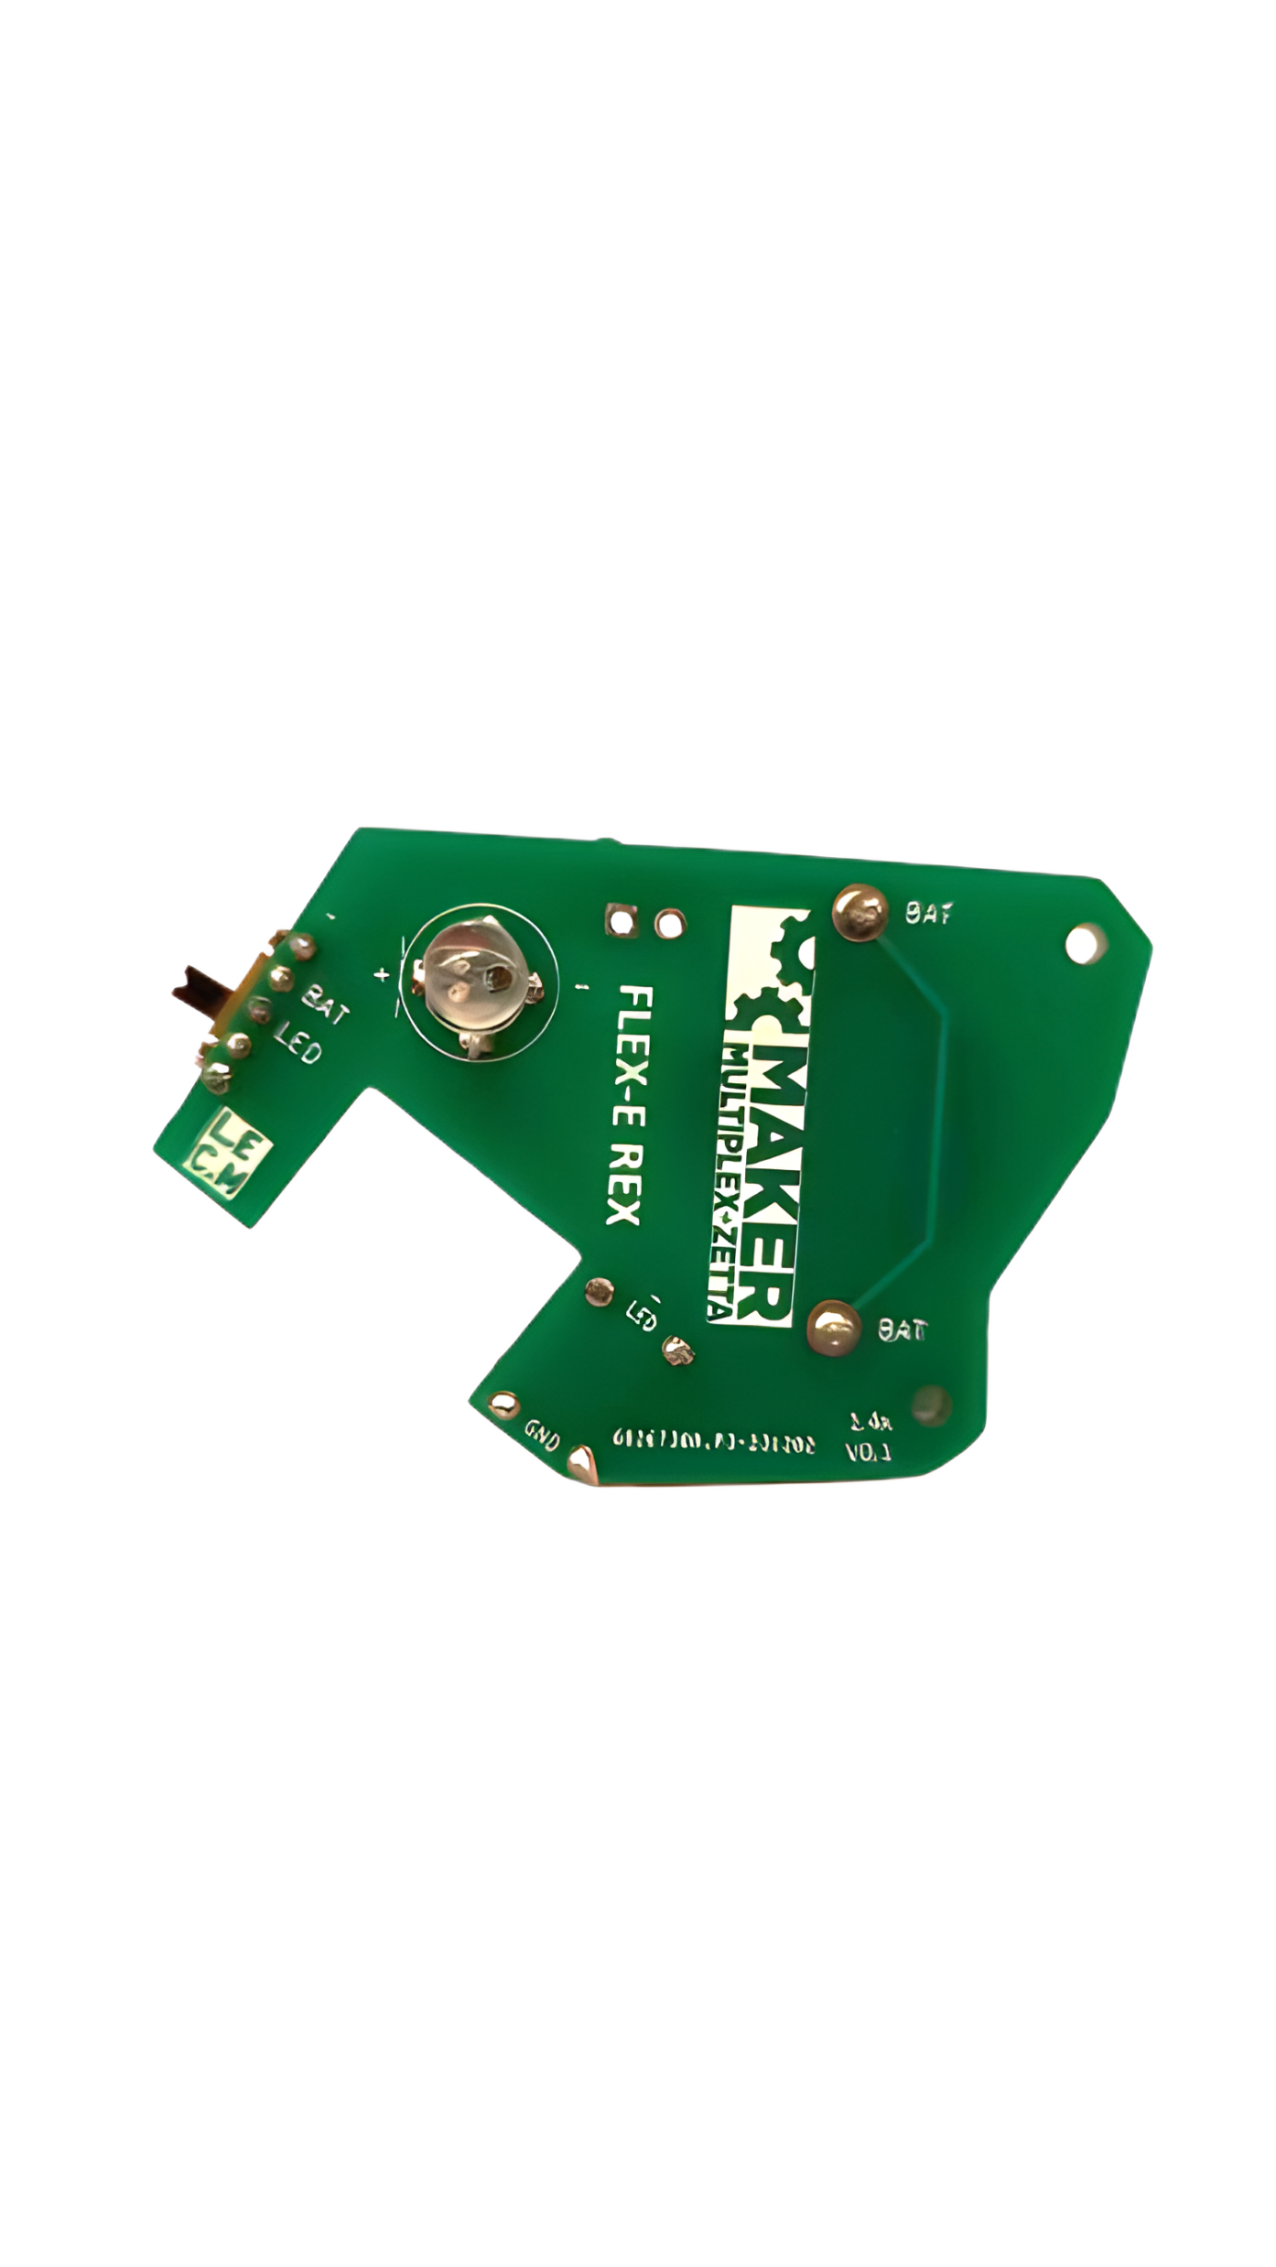

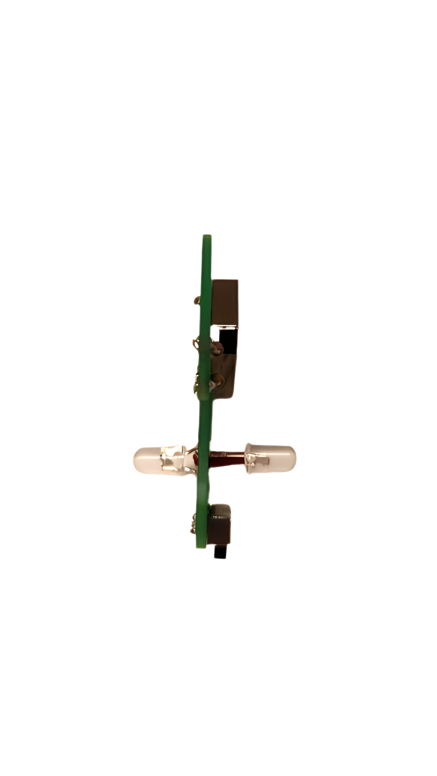
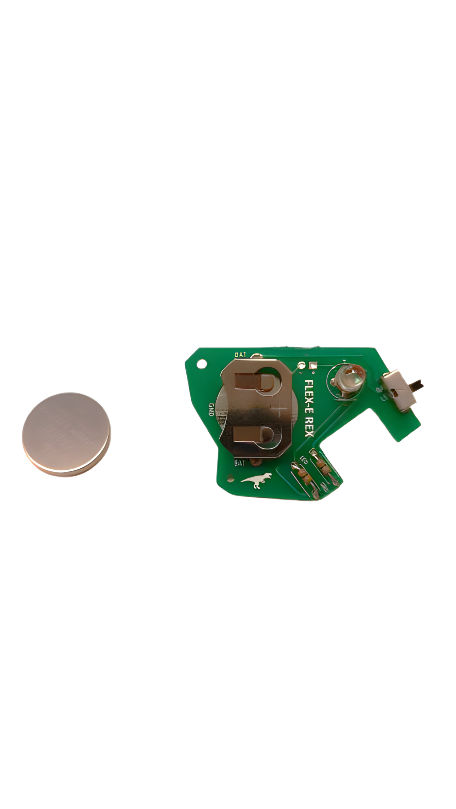
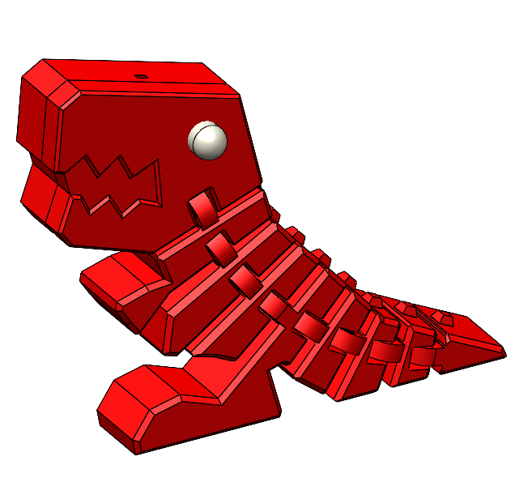
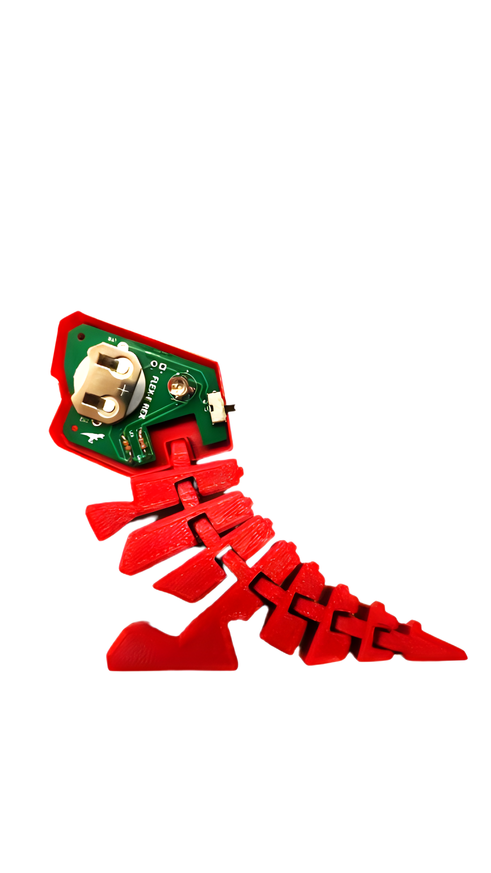
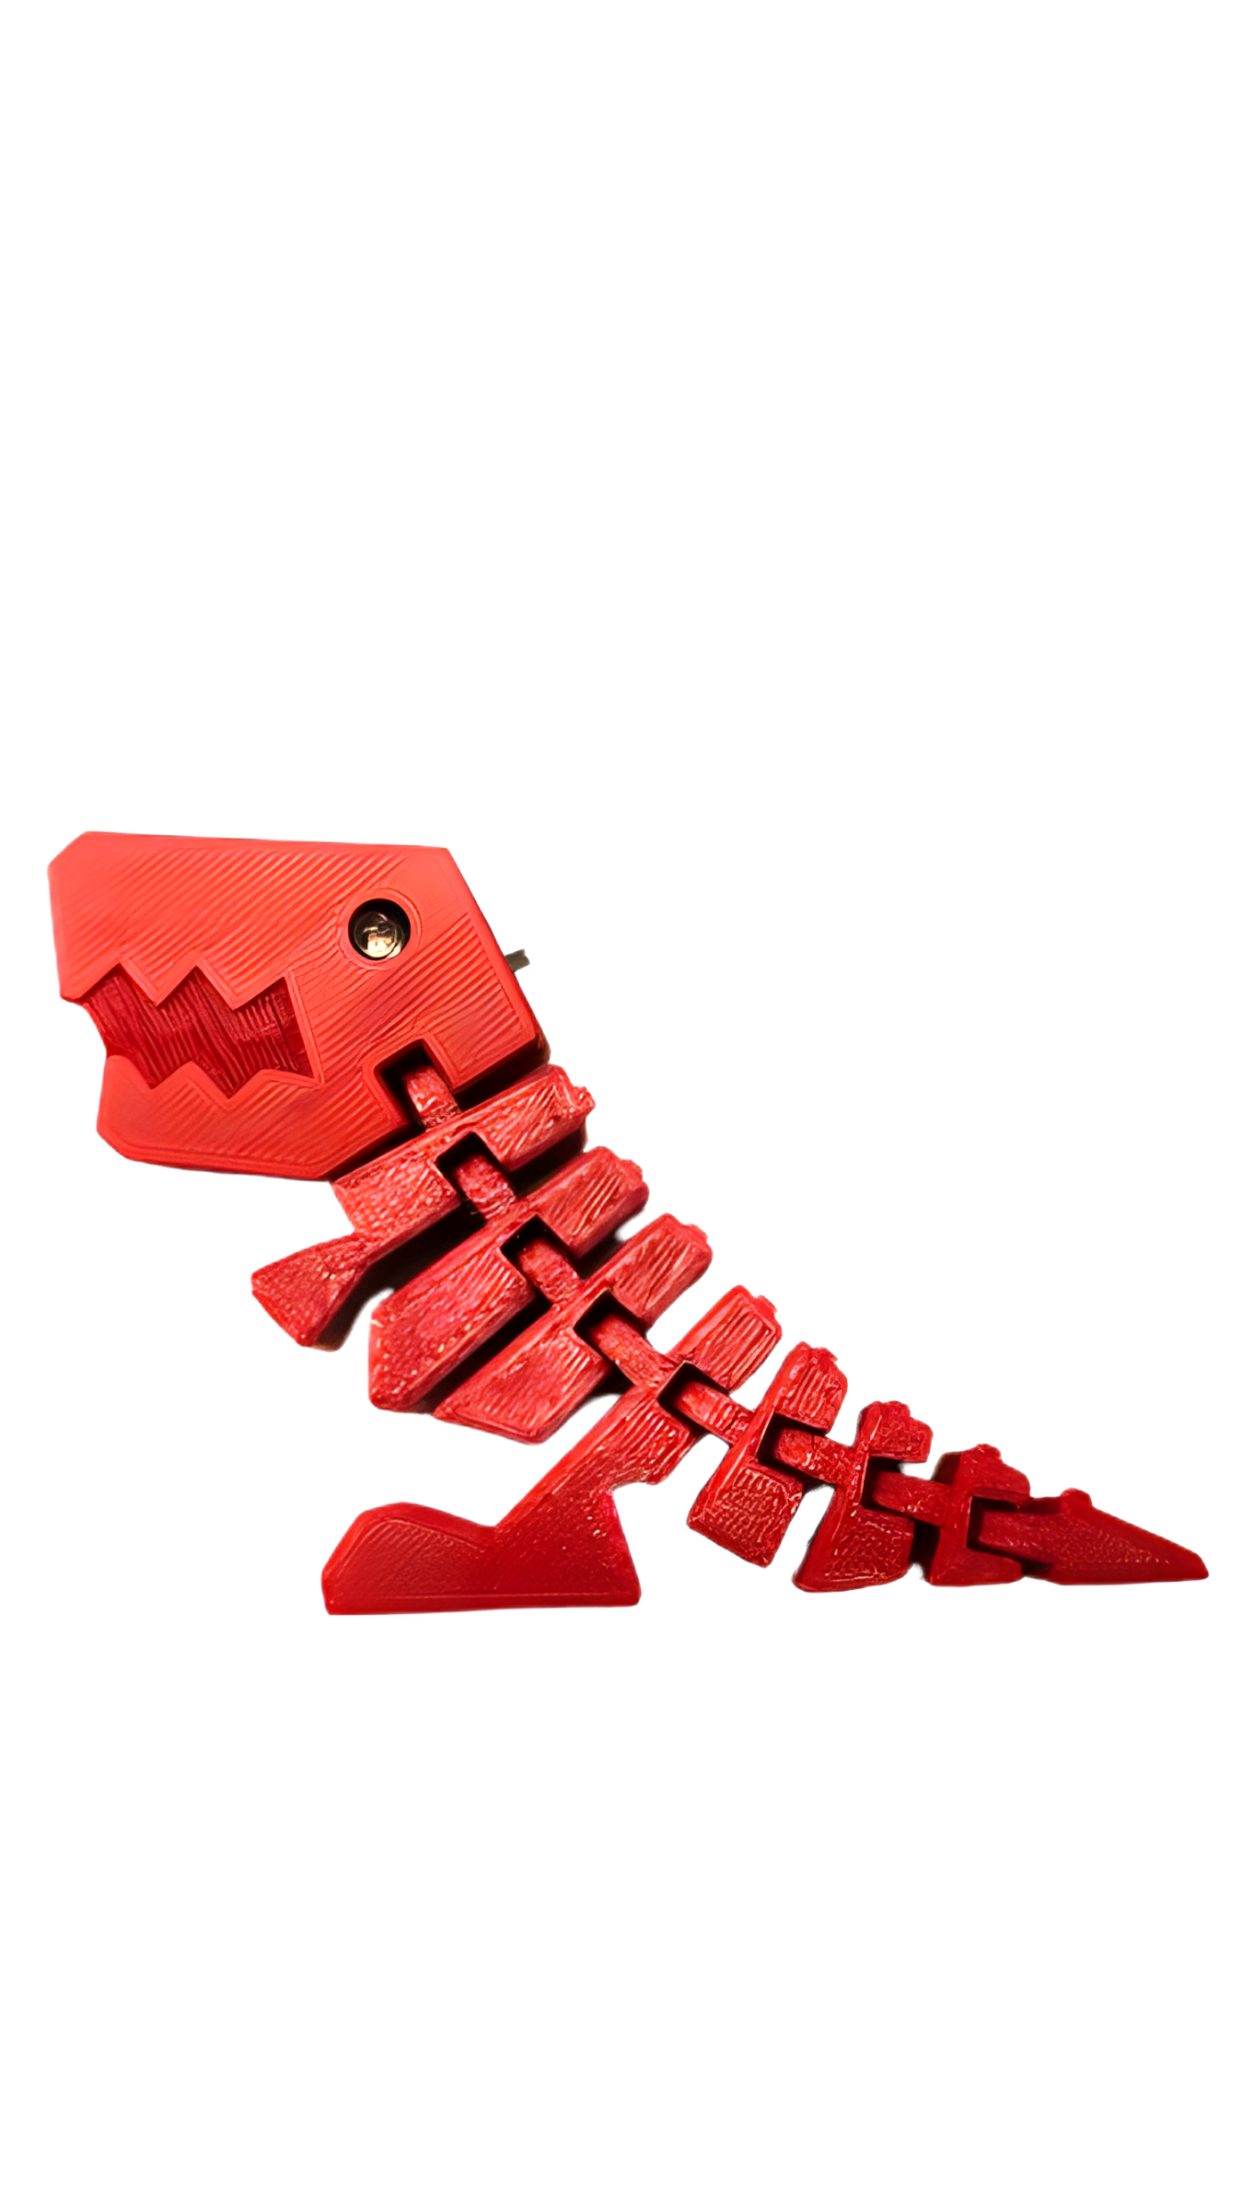
5. Insert the second LED from the backside while aligning the flat part on the LED with the line on the PCB. Try to pull the LED as close to the board as possible by wiggling the LED and pushing into the board. Try to keep the LED centered and trim the wires after.
Flex-E Rex Soldering Kit
6. Insert coin cell and check that both LEDs work with the switch. If the LEDs do not work, check that the battery isn’t upside down or that the LEDs aren’t soldered backwards! The flat spot on the LED should be on the same side as the flat line on the PCB.
7. Place the assembled PCB into the Flex-E Rex body while aligning the PCB holes with posts and then attach the second half of the head.
Finished!
Find more classes and trainings at our website!
https://schulich.libguides.com/m2z
5. Insert the second LED from the backside while aligning the flat part on the LED with the line on the PCB. Try to pull the LED as close to the board as possible by wiggling the LED and pushing into the board. Try to keep the LED centered and trim the wires after.
Flex-E Rex Soldering Kit
6. Insert coin cell and check that both LEDs work with the switch. If the LEDs do not work, check that the battery isn’t upside down or that the LEDs aren’t soldered backwards! The flat spot on the LED should be on the same side as the flat line on the PCB.
7. Place the assembled PCB into the Flex-E Rex body while aligning the PCB holes with posts and then attach the second half of the head.
Finished!
Find more classes and trainings at our website!
https://schulich.libguides.com/m2z

Slide 2
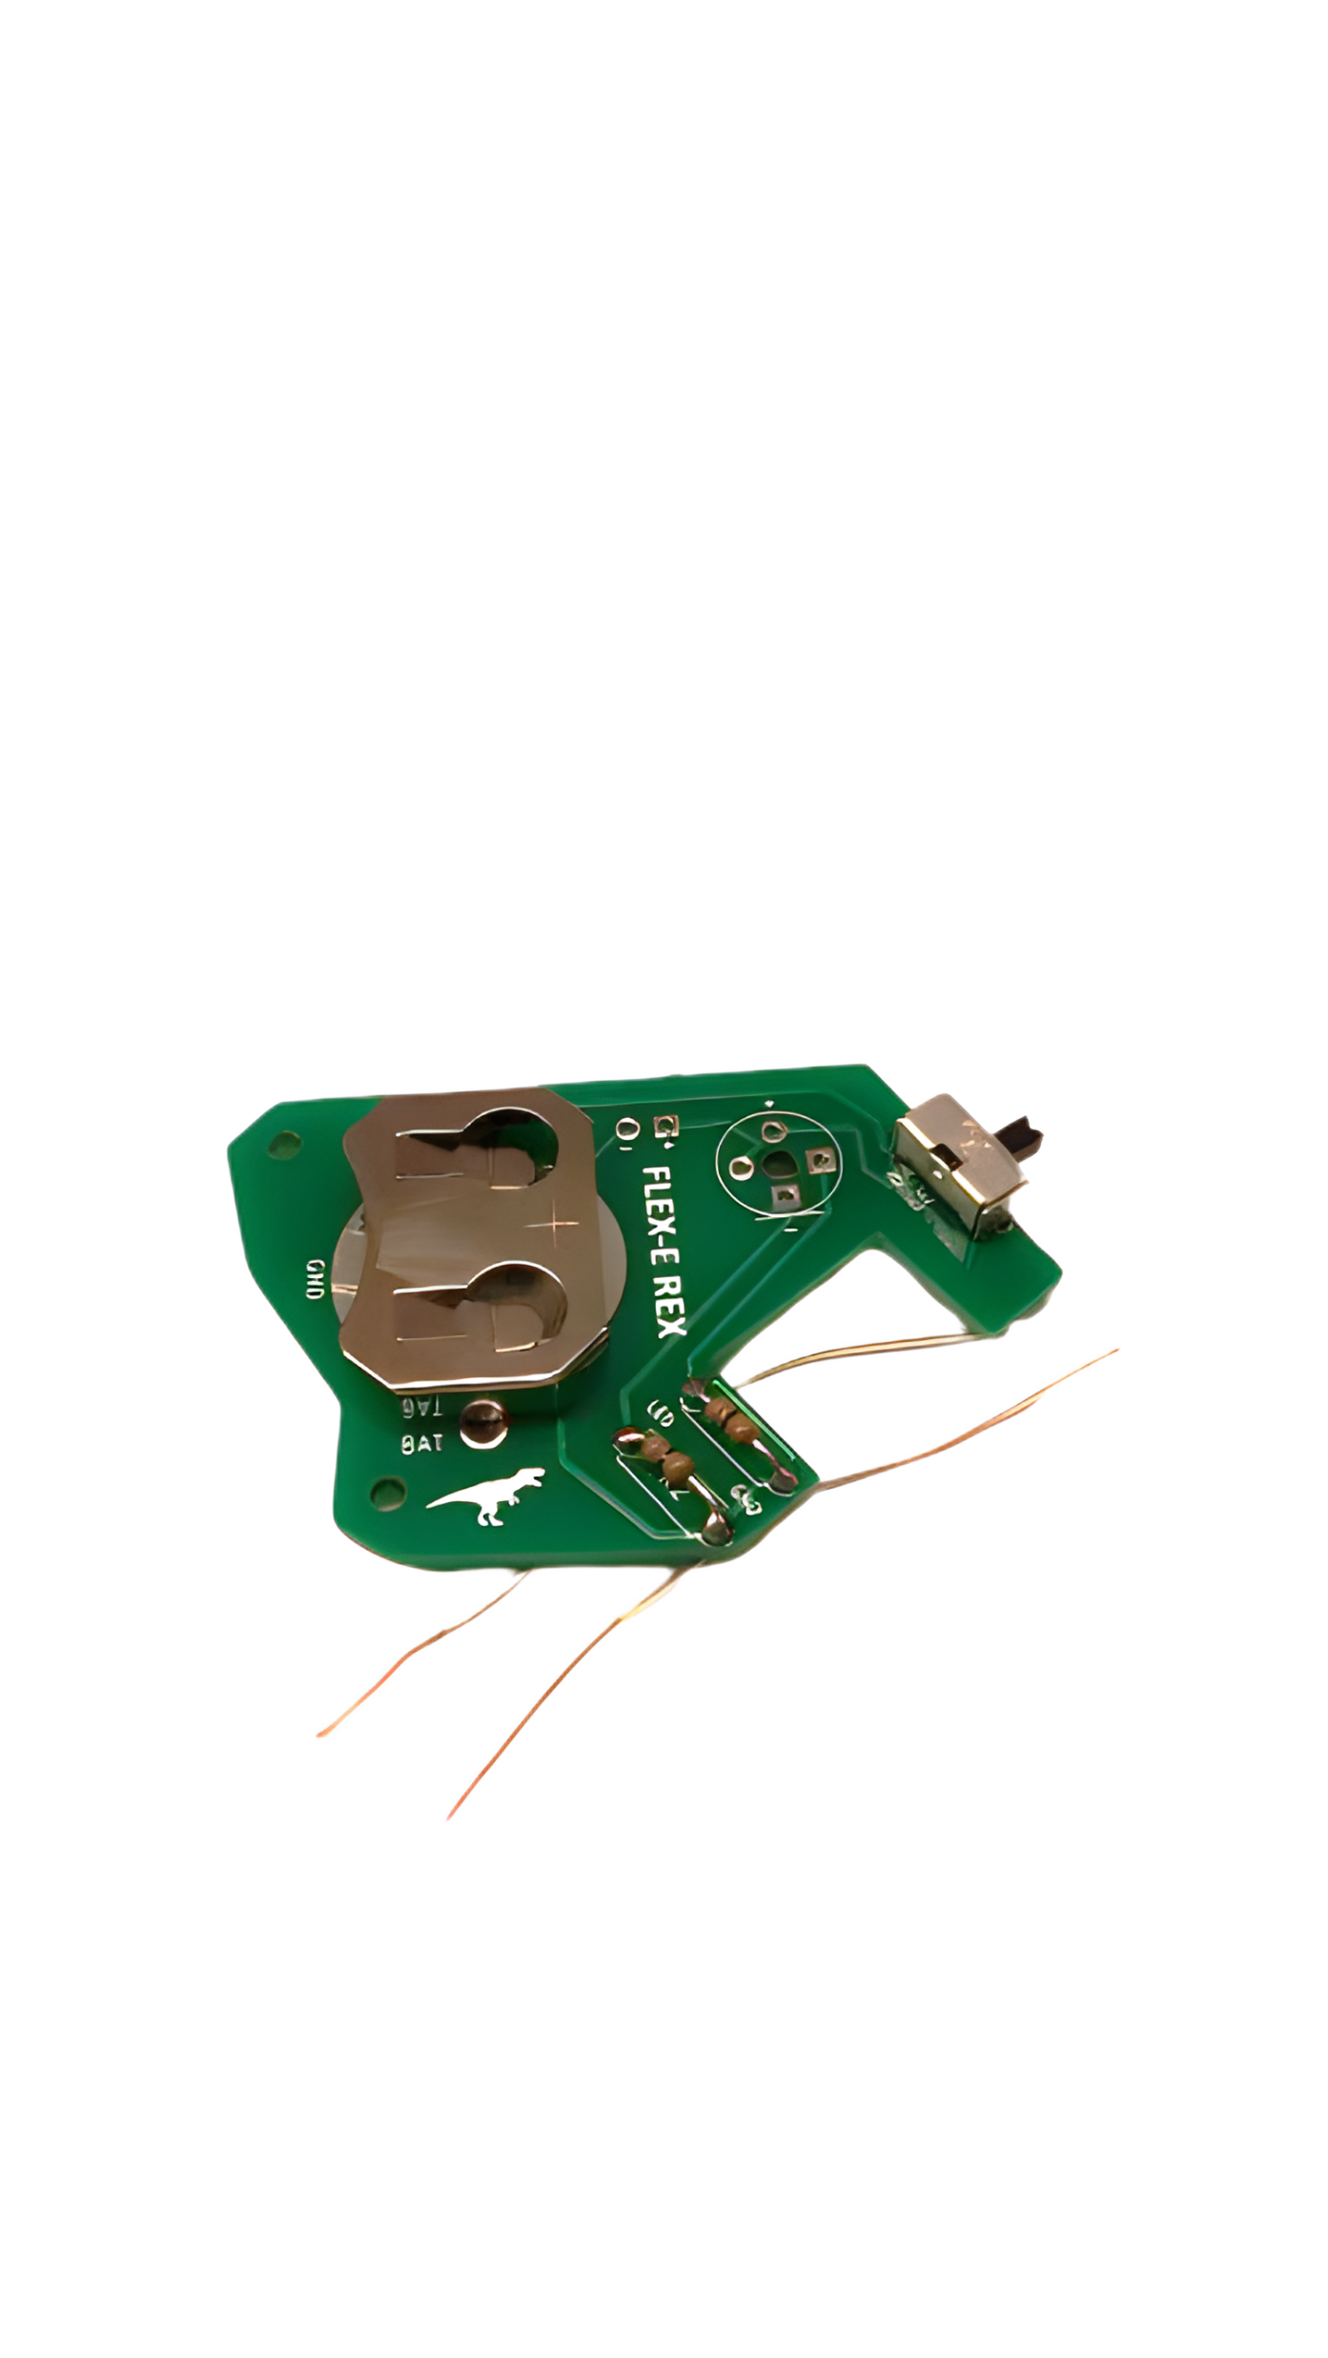
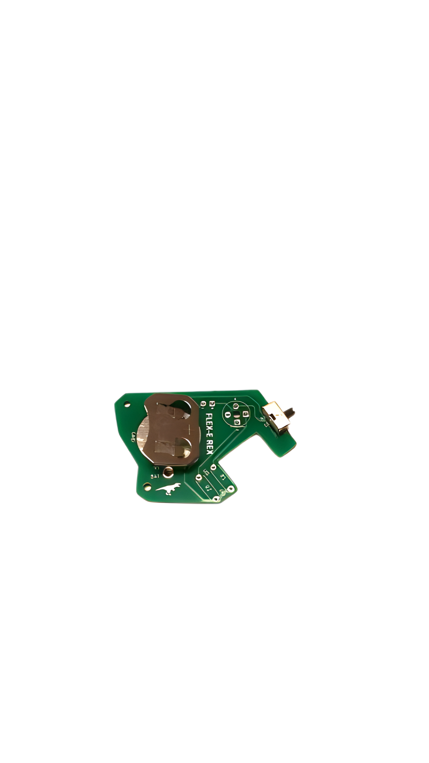
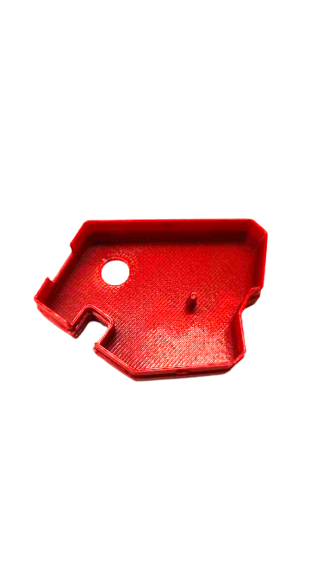
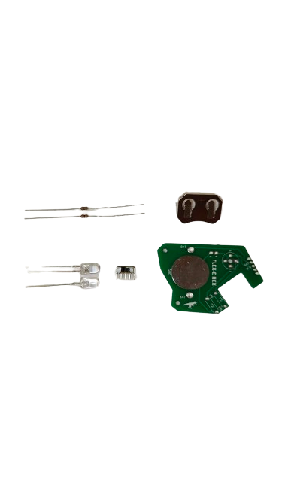
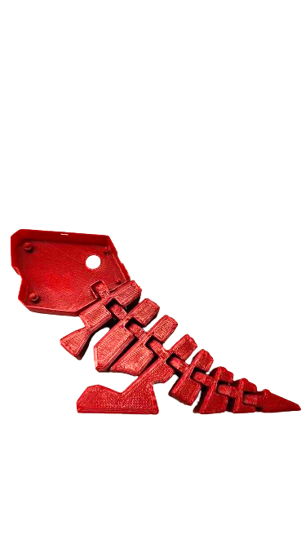
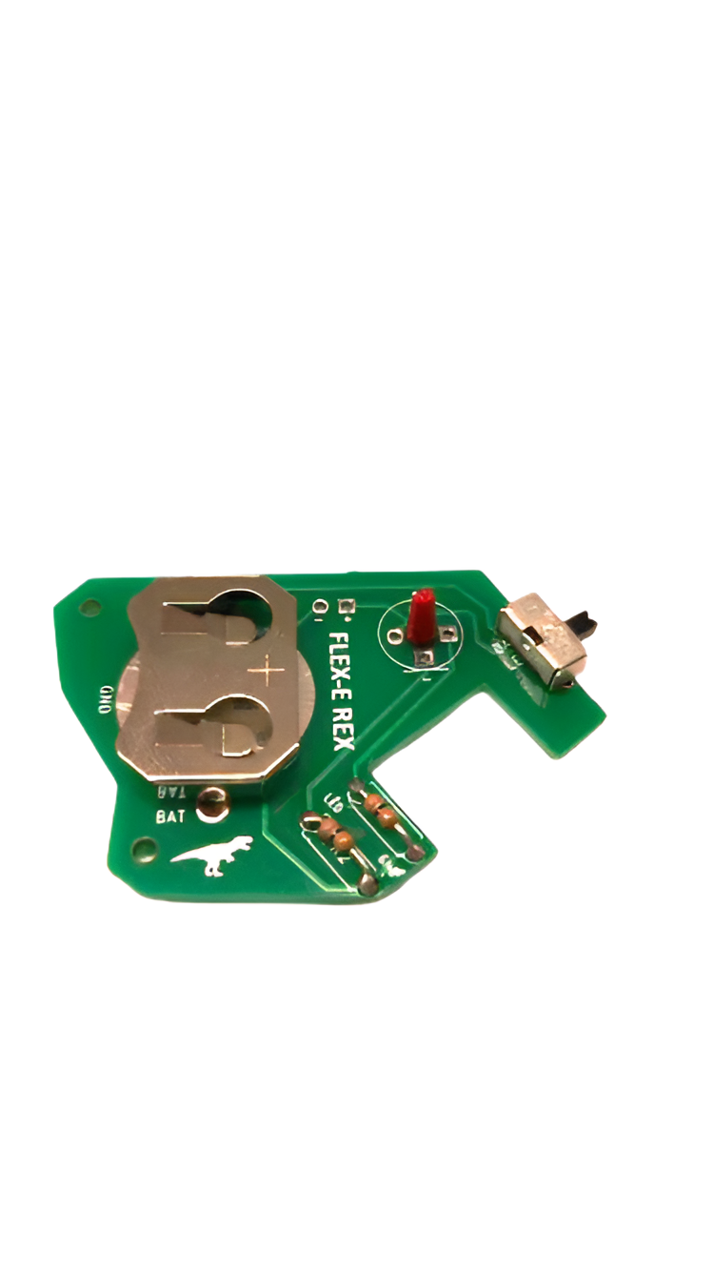
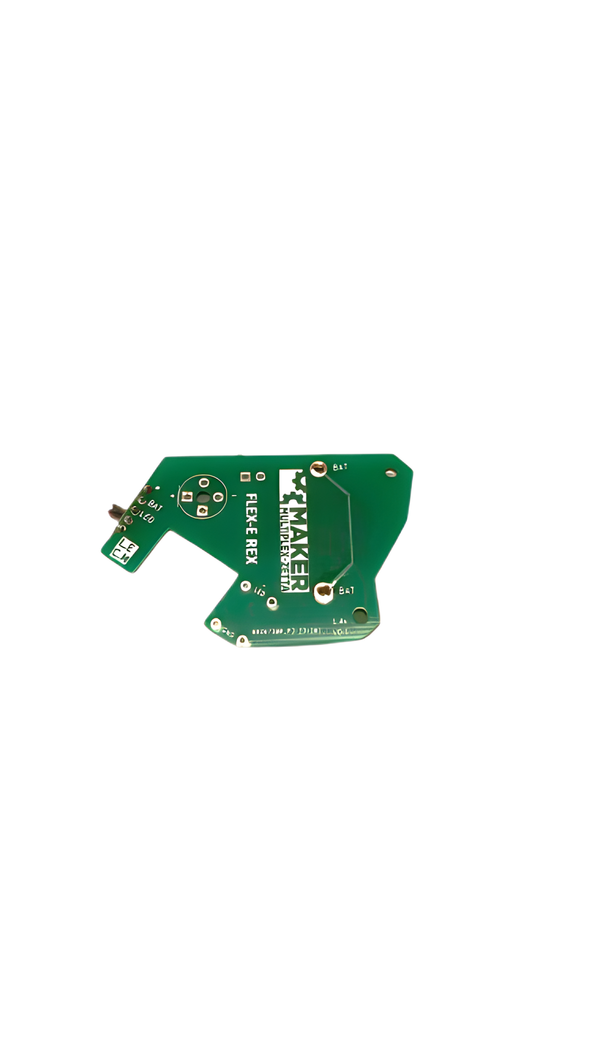
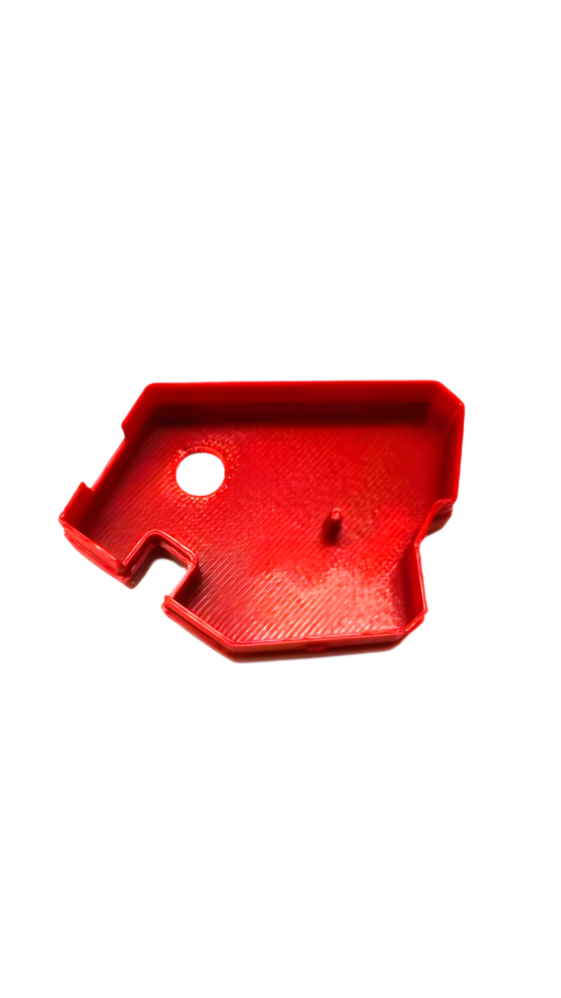
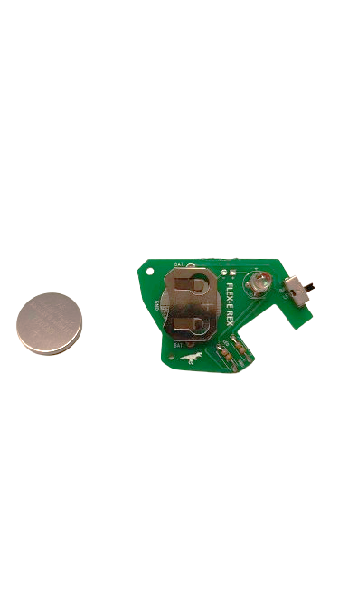
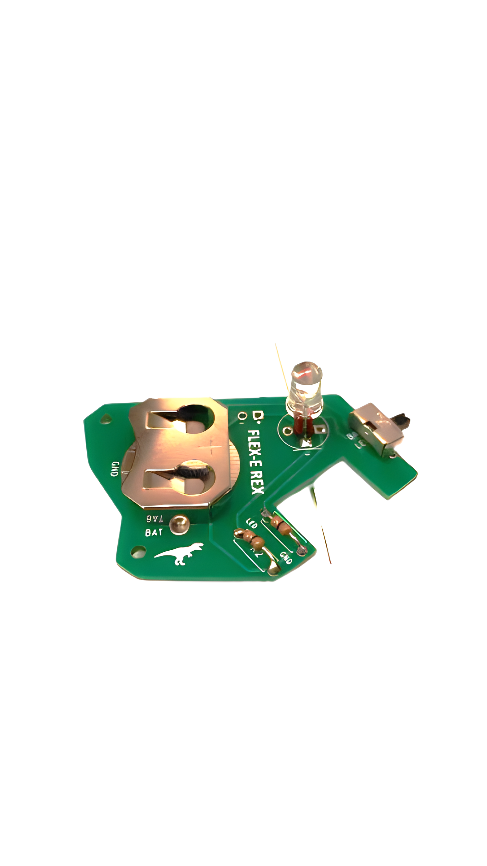
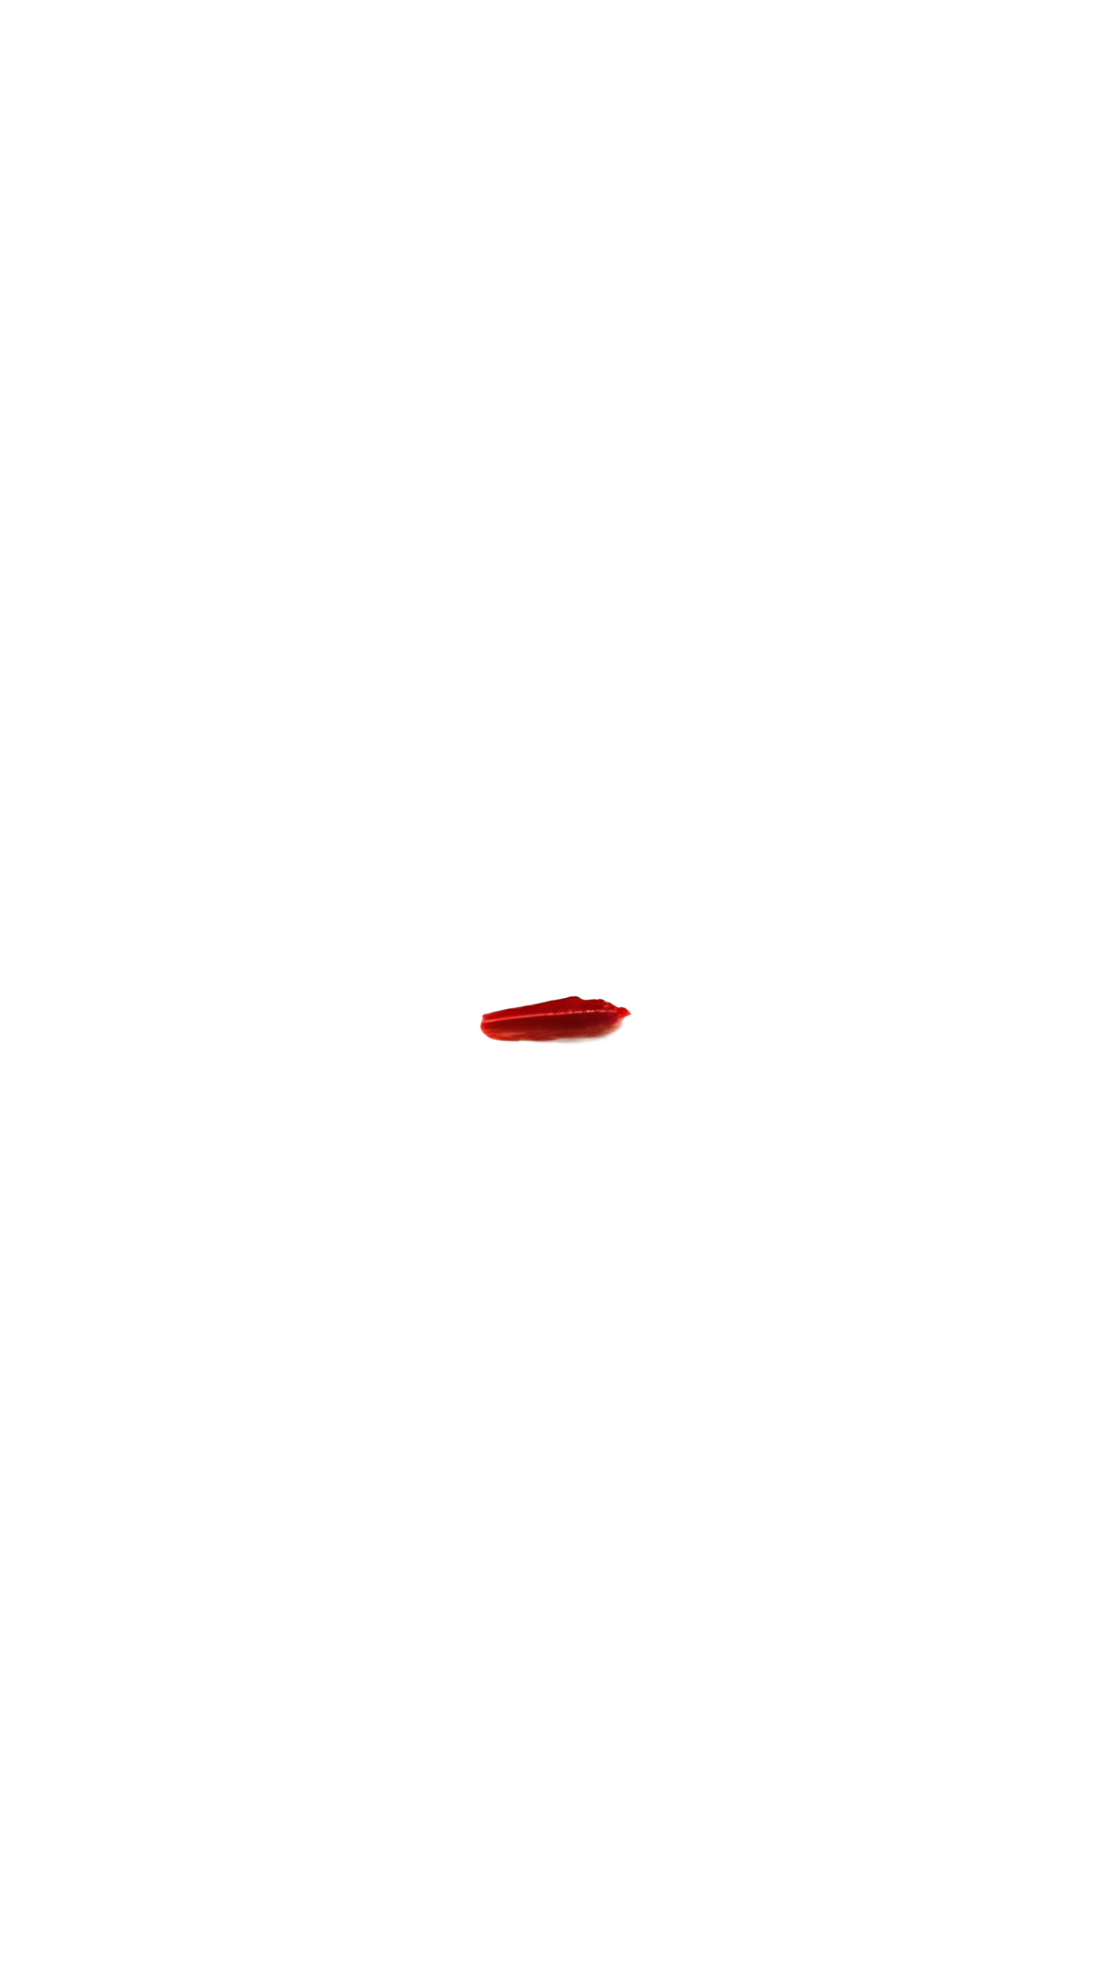
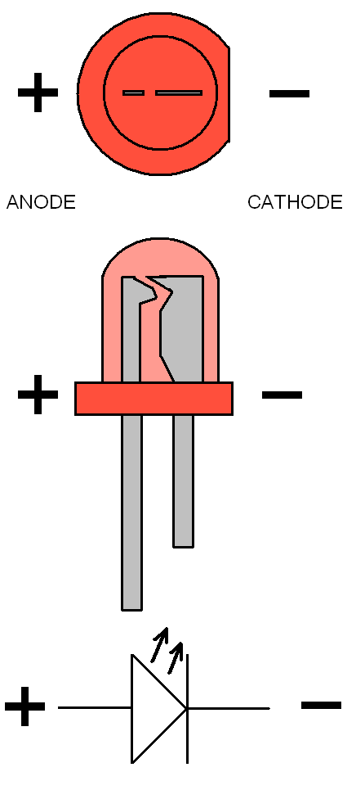
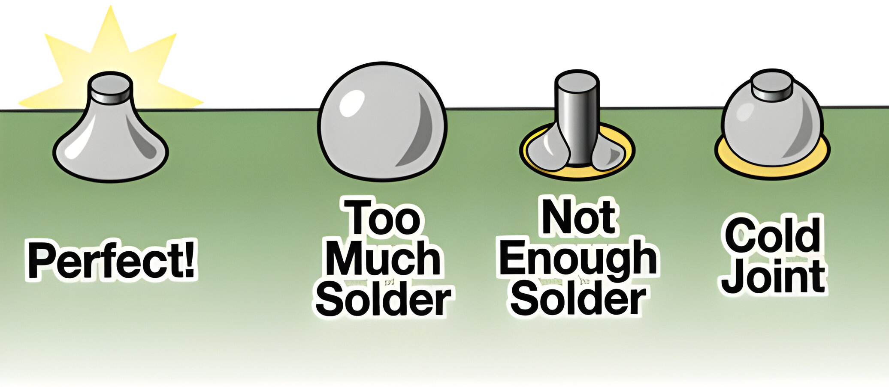
Parts List
2. Place and solder the resistors as shown. Make sure to trim the leads after soldering!
2x Resistors
1x Battery Holder
1x Flex-E Rex Head Half
2x LEDs
1x Switch
1x PCB
3. Locate the LED spacer in the bag or still attached to the inside of the Flex E Rex head half and insert into the PCB eye hole as shown.
1x Coin Cell
1x Flex-E Rex Body and Head
Assembly Steps
0. Pre-heat soldering iron to ~350*C/~650*F
1. Place the switch and battery holder as shown and solder into place from the backside. For a good solder joint apply heat to both the pad and component for 1-3 seconds and then press solder into the heated area. See the image below for tips!
!!Note the orientation of the battery holder!!
4. Place and solder the first LED against the spacer as shown. Align the line on the PCB and the flat part of the LED for correct polarity. Try to center the LED and trim excess wire when done.
Parts List
2. Place and solder the resistors as shown. Make sure to trim the leads after soldering!
2x Resistors
1x Battery Holder
1x Flex-E Rex Head Half
2x LEDs
1x Switch
1x PCB
3. Locate the LED spacer in the bag or still attached to the inside of the Flex E Rex head half and insert into the PCB eye hole as shown.
1x Coin Cell
1x Flex-E Rex Body and Head
Assembly Steps
0. Pre-heat soldering iron to ~350*C/~650*F
1. Place the switch and battery holder as shown and solder into place from the backside. For a good solder joint apply heat to both the pad and component for 1-3 seconds and then press solder into the heated area. See the image below for tips!
!!Note the orientation of the battery holder!!
4. Place and solder the first LED against the spacer as shown. Align the line on the PCB and the flat part of the LED for correct polarity. Try to center the LED and trim excess wire when done.

